Slide 1
CST 205 OOP :Object modeling using UML

Slide 2
OBJECTIVES
To explain about class diagram.
To illustrate class diagram
To give an overview of object diagram
To illustrate object diagram

Slide 3
CLASS DIAGRAMS
A class diagram describes the static structure of a system.
The static structure of a system comprises a number of class diagrams and their dependencies.
A class diagram in the Unified Modeling Language (UML) is a type of static structure diagram that describes the structure of a system by showing the system's:
classes,
their attributes,
operations (or methods),
and the relationships among objects.

Slide 4
Classes
The classes represent entities with common features, i.e., attributes and operations.
Classes are represented as solid outline rectangles with compartments.
Classes have a mandatory name compartment where the name is written centered in boldface.
The class name is usually written using mixed case convention and begins with an uppercase (e.g. LibraryMember).
Object names on the other hand, are written using a mixed case convention, but starts with a small case letter (e.g., studentMember).
Classes have optional attributes and operations compartments

Slide 5
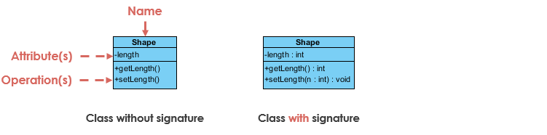
UML Class Notation
Class Name:
The name of the class appears in the first partition.
Class Attributes:
Attributes are shown in the second partition.
The attribute type is shown after the colon.
Attributes map onto member variables (data members) in code

Slide 6
UML Class Notation
Class Operations (Methods):
Operations are shown in the third partition. They are services the class provides.
The return type of a method is shown after the colon at the end of the method signature.
The return type of method parameters are shown after the colon following the parameter name. Operations map onto class methods in code.

Slide 7
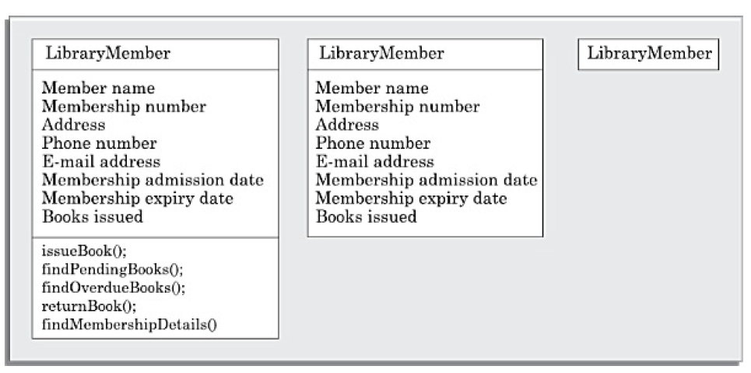
REPRESENTATION OF CLASSES IN CLASS DIAGRAM

Slide 8
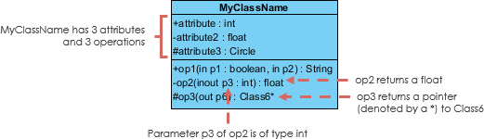
UML Class Notation

Slide 9
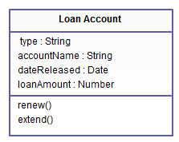
UML Class Notation

Slide 10
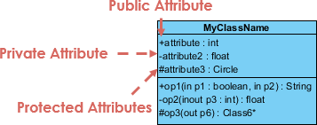
UML Class Notation
Class Visibility
The +, - and # symbols before an attribute and operation name in a class denote the visibility of the attribute and operation.
+ denotes public attributes or operations
- denotes private attributes or operations
# denotes protected attributes or operations

Slide 11
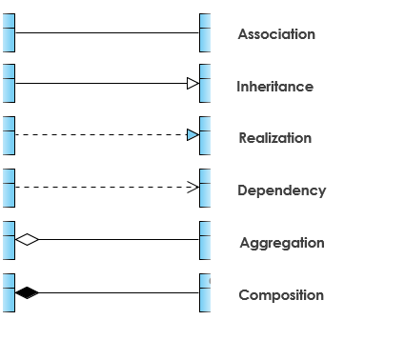
Class Relationships

Slide 12
Association
Associations are relationships between classes in a UML Class Diagram. They are represented by a solid line between classes.
When two classes are associated, they can take each others help (i.e. invoke each others methods) to serve user requests.
If one class is associated with another bidirectionally, the object of one class to invoke the methods of the corresponding object of the other class.
A Student can register in one Elective subject. In this example, the class Student is associated with the class ElectiveSubject.

Slide 13
Types of Associations
Consider another example of association between two classes: Library Member borrows Books. Here, borrows is the association between the class LibraryMember and the class Book.
Unary association: Association between the same class .
Example :Person teaches Person, Person marries Person
Binary association: Association between two classes; drawn as a solid path connecting two classes.
Example : Person sits on a Chair.
Ternary association: Association among three classes.
On the same line, n-ary association is an association among n classes.

Slide 14
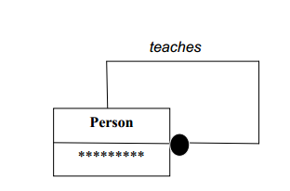
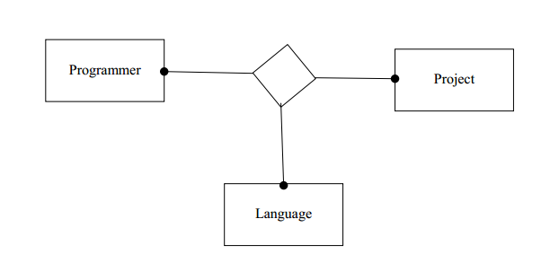
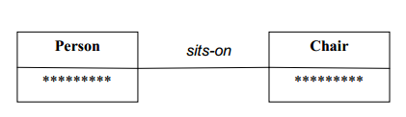
Types of Associations
Unary Association Ternary Association
Binary Association

Slide 15
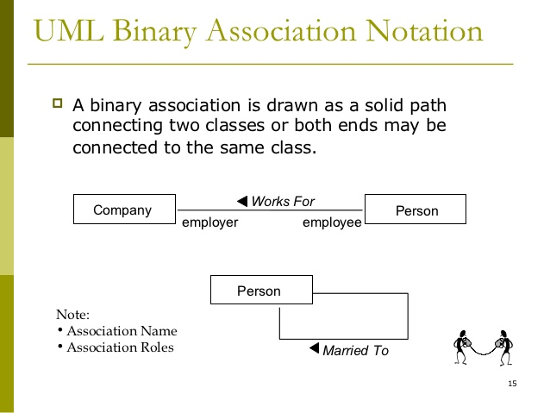
Association
Associations may have an
Association name optional black triangle ; point of triangle indicate the direction in which to read the name

Slide 16
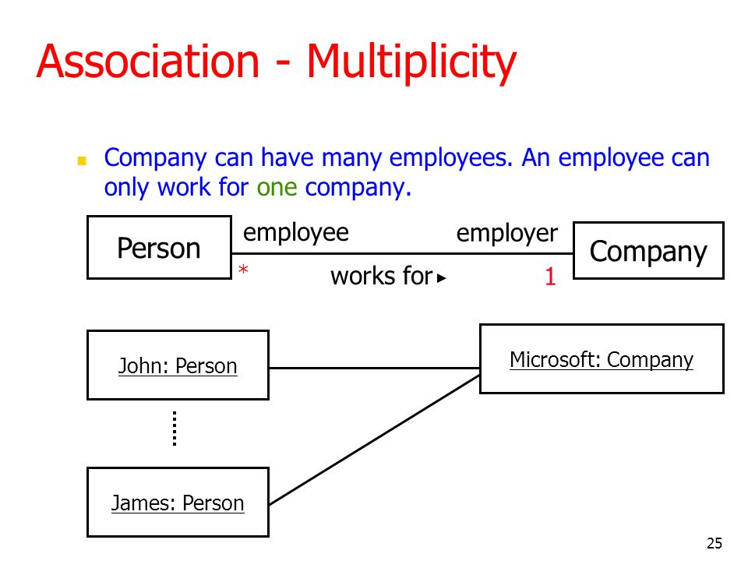
Multiplicity (Cardinality)
Multiplicity: It specifies range of allowable associated classes; denoted by lower bound ……. Upper bound
Eg: 0....1
Eg: 0....* means 0 to many

Slide 17
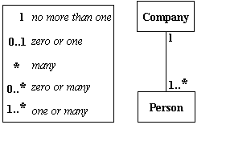
Multiplicity

Slide 18
Associations and Link
An association describes a group of similar links.
Alternatively, we can say that a link can be considered as an instance of an association relation.
"A person works for a company. Ram works for Infosys. Hari works for TCS.“
In this example, an association relationship named works for exists between the classes Person and Company.
Ram works for Infosys, this implies that a link exists between the object Ram and the object Infosys.
Similarly, a works for link exists between the objects Hari and TCS.

Slide 19
TYPES OF ASSOCIATION
COMPOSITION
AGGREGATION

Slide 20

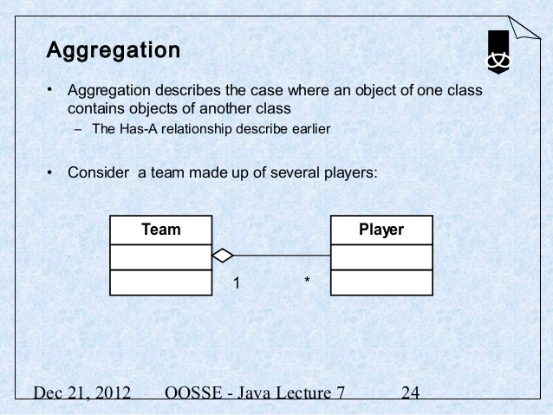
Aggregation
Aggregation represent part/whole relationships among objects.
A special type of association.
It represents a "part of" relationship.(Class2 is part of Class1)
As an example, consider the following—A Book object can have upto ten Chapters.
Aggregation implicit a relationship where the child can exist independently of the parent.

Slide 21
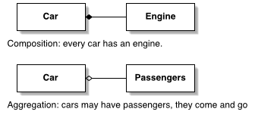
COMPOSITION
Composition is a restricted form of Aggregation in which two entities are highly dependent on each other.
It represents part-of relationship.
A special type of aggregation where parts are destroyed when the whole is destroyed.
Objects of Class2 live and die with Class1.
Class2 cannot stand by itself.

Slide 22
Dependency
A class is said to be dependent on another class, if any changes to the latter class necessitates a change to be made to the dependent class..
A dependency relation between two classes shows that any change made to the independent class would require the corresponding change to be made to the dependent class.
Exists between two classes if changes to the definition of one may cause changes to the other .
Class1 depends on Class2.

Slide 23

Dependency
The figure below shows another example of dependency.
The Person class might have a hasRead method with a Book parameter that returns true if the person has read the book (perhaps by checking some database).

Slide 24
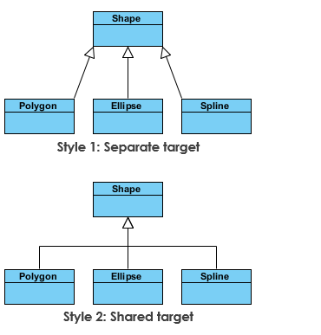
INHERITANCE
The inheritance relationship is represented by means of an empty arrow pointing from the subclass to the superclass. The arrow may be directly drawn from the subclass to the superclass.

Slide 25
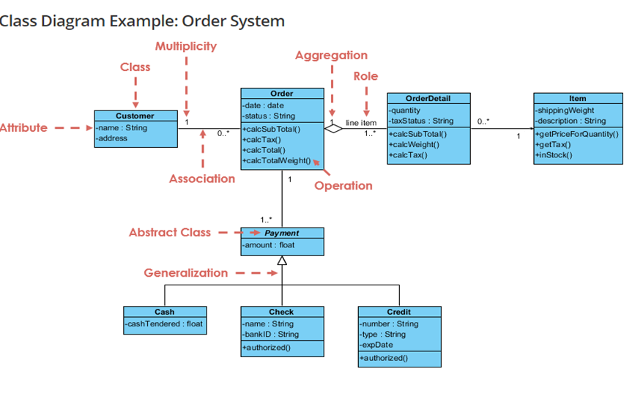
C

Slide 26
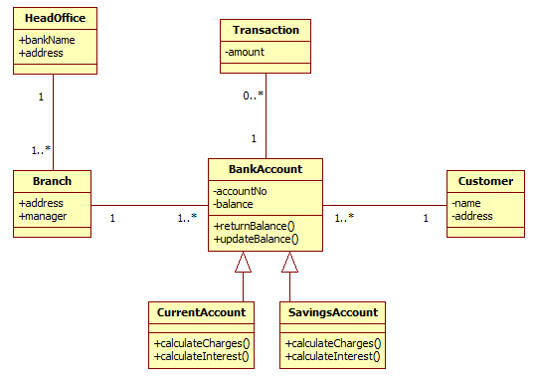
CLASS DIAGRAM OF BANKING SYSTEM

Slide 27
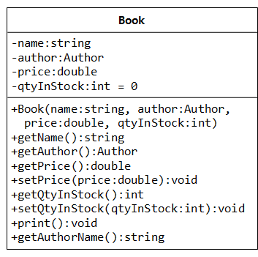
EXAMPLES OF CLASS DIAGRAM
Represent the following entities using UML class diagram
i) Book ii) Vehicle ?? iii)Employee??

Slide 28
Object diagrams
Object diagrams shows the snapshot of the objects in a system at a point in time.
Since it shows instances of classes, rather than the classes themselves, it is often called as an instance diagram.
The objects are drawn using rounded rectangles.
An Object Diagram can be referred to as a screenshot of the instances in a system and the relationship that exists between them.

Slide 29
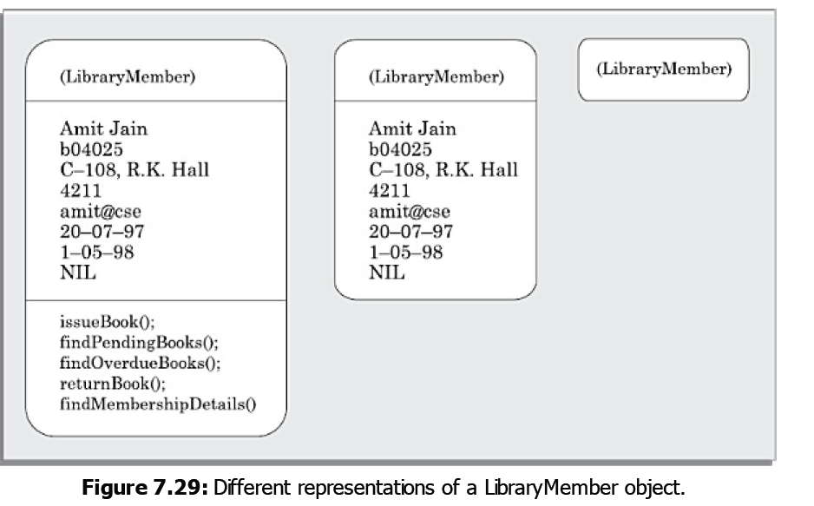
Object diagrams

Slide 30
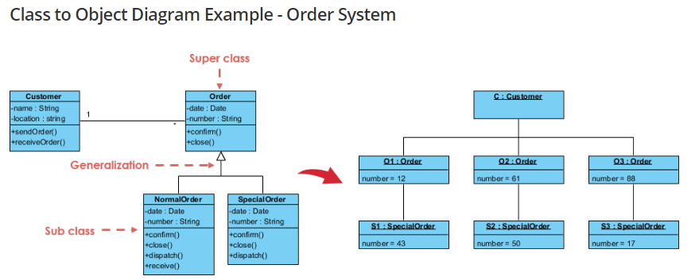
Object diagrams

Slide 31
Purpose of Class diagrams
The class diagram is the main building block of object-oriented modeling.
It is used for general conceptual modeling of the structure of the application, and for detailed modeling translating the models into programming code.
Analysis and design of the static view of an application.
Describe responsibilities of a system.
Base for component and deployment diagrams.
Forward engineering.

Slide 32
Purpose of Object diagrams
Model the static design(similar to class diagrams ) or structure of a system.
Helps us to understand the functionalities that the system should deliver to the users.
Understand relationships between objects.
Verify the class diagrams for completeness and accuracy by using Object Diagrams as specific test cases.

Slide 33
SUMMARY
We discussed the syntax and semantics of some class diagram and object diagram which can be constructed using UML.

Slide 34
Thanks!
Any questions?

